Slide 1
TED Talk
Bits Please
Brandon Dooley, Owen Duffy, Paul Devaney, Cian Donoghue, Eoin Dowling

Slide 2
_______ has made the greatest contribution to the development of computing.

Slide 3
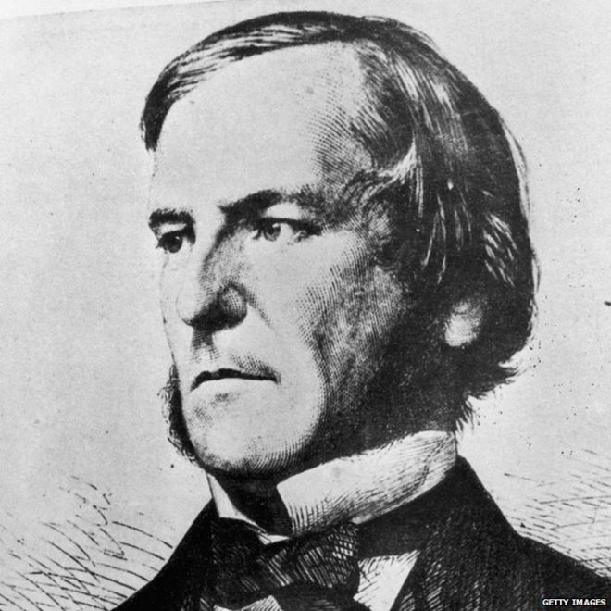
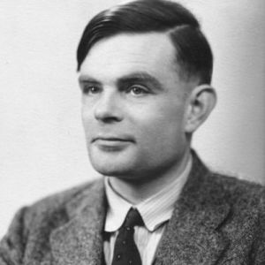
George Boole (1815 – 1864)
ALAN TURING (1912-1954)

Slide 4



Tim Berners-Lee (1955 - )
BILL GATES (1955 - )
STEVE JOBS (1955 – 2011)

Slide 5

Our suggestion is a little less obvious..

Slide 6
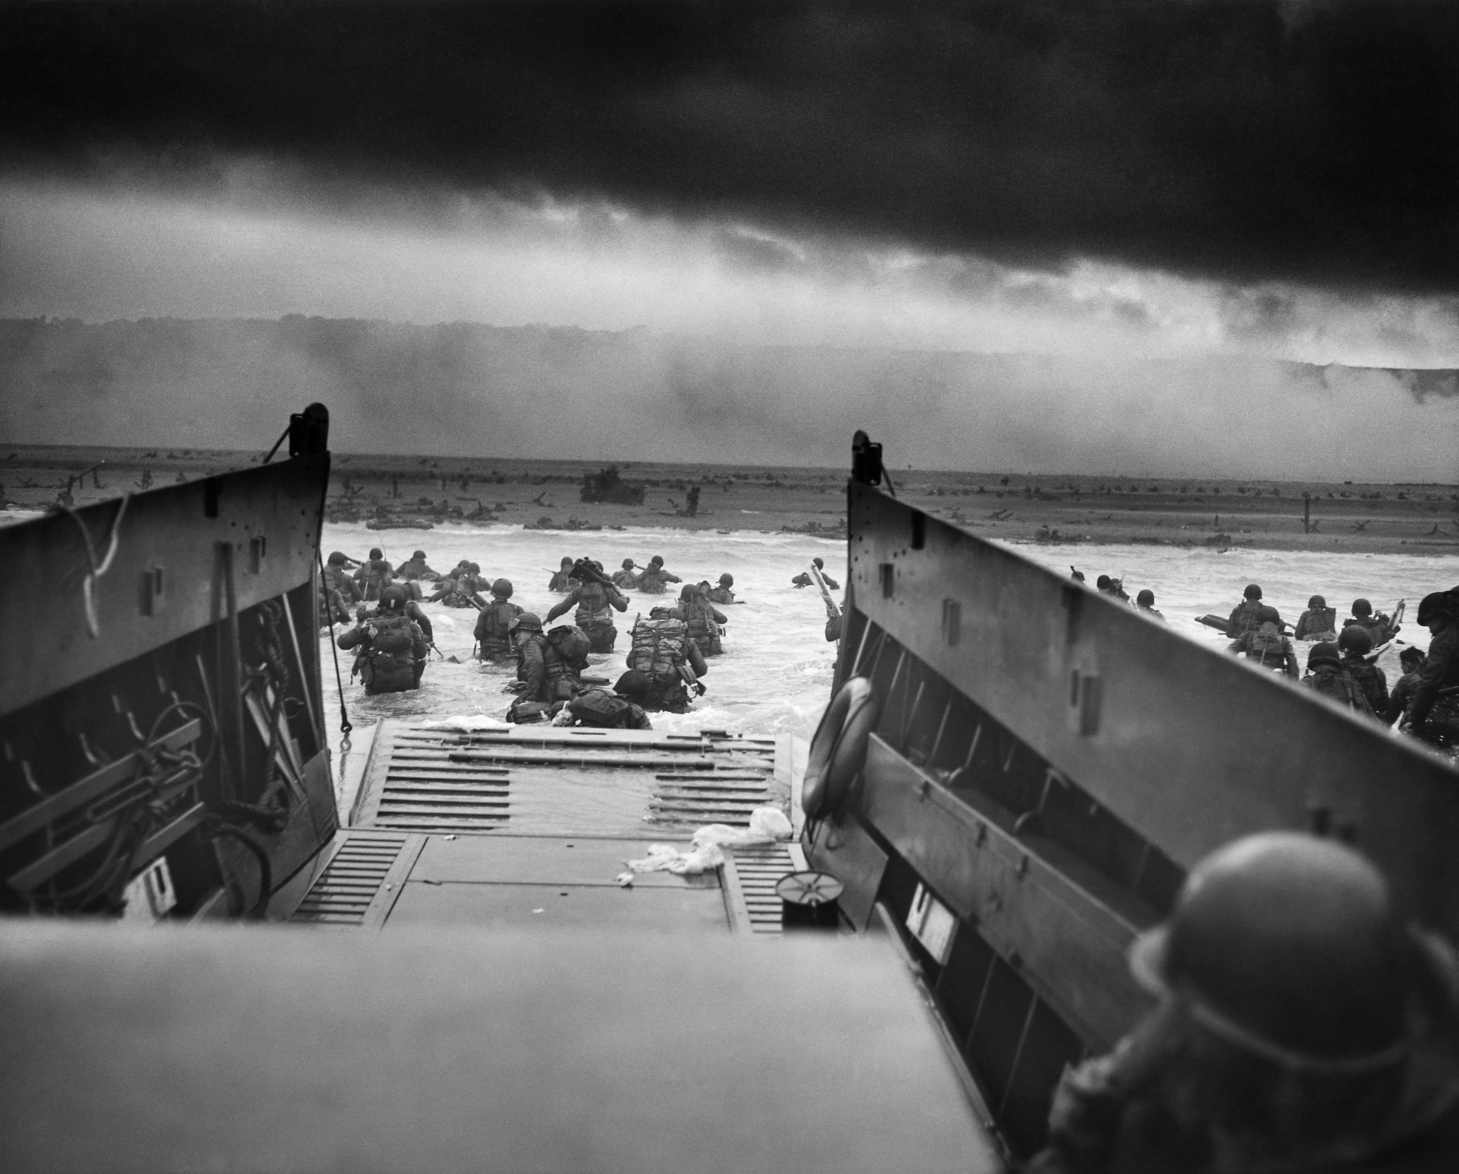
But what about
WAR?

Slide 7

HAS WAR DRIVEN TECHNOLOGICAL ADVANCEMENT?
LETS HAVE A LOOK…
YOU MAY BE SHOCKED AT WHAT CERTAIN TECHNOLOGIES WERE ORIGINALLY INVENTED FOR!

Slide 8
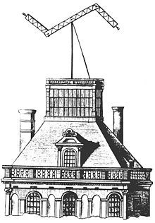
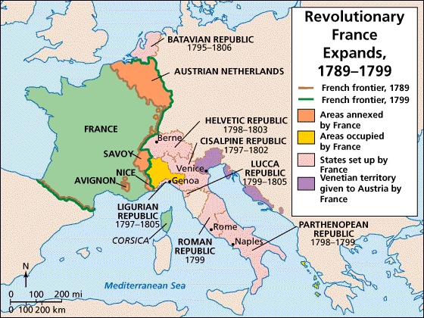
TelegraphY
(1790-1795) in Revolutionary France, the Chappe brothers invented a primitive, optical telegraph network called a “Semaphore” Telegraph for central intelligence purposes.
Original Intended Purpose?

Slide 9

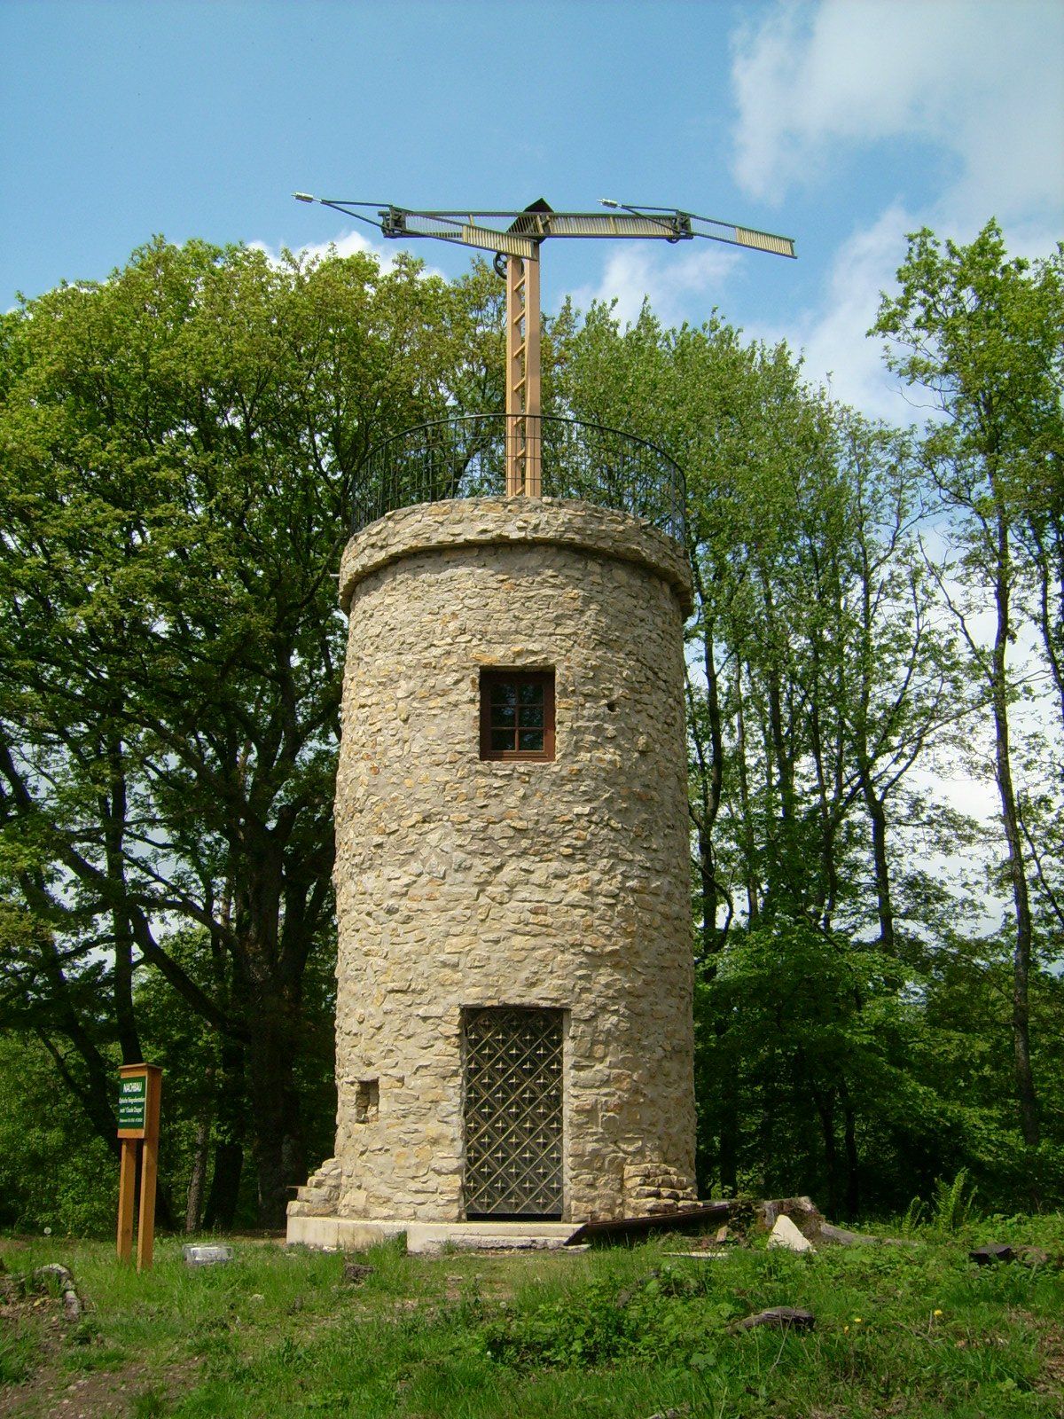

Prussia Immediately followed, and very quickly the telegraph took off in Europe.

Slide 10
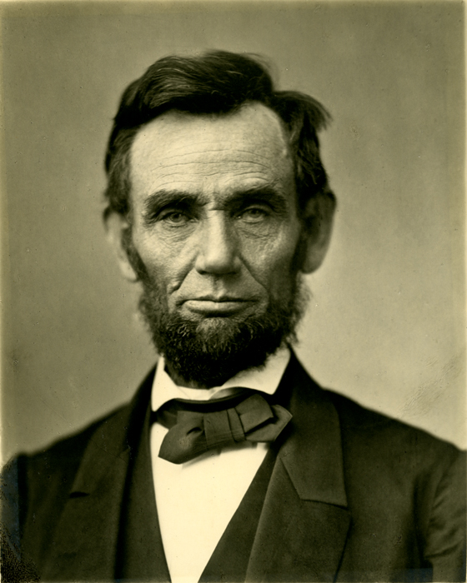
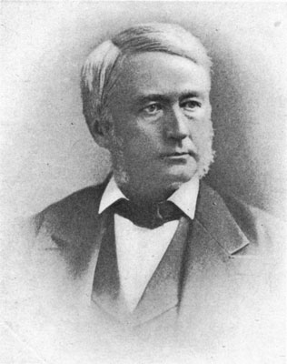
What about in the us?
Telegraphs in the US never really took off to the same extent until…
April 19, 1861
When President Lincoln founded the U.S. Military Telegraph Corps

Slide 11

Collossus – World War II
Used thermionic valves (vacuum tubes) to perform Boolean and counting operations.
Regarded as the world's first programmable, electronic, digital computer.

Slide 12
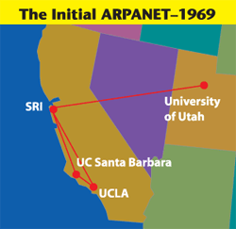
The Internet
1960s, the U.S. Department of Defense funded a project called ARPANET.
Developed the technologies and protocols necessary to allow multiple computers to connect directly to one another.

Slide 13
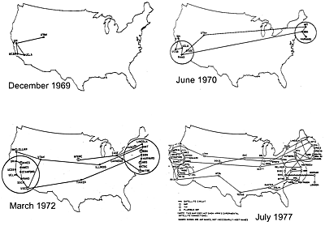
The Internet
Multiple separate networks could be joined into a network of networks.
In 1983, ARPANET was divided into two parts, MILNET, to be used by military and defense agencies, and a civilian version of ARPANET.

Slide 14

GPS – Cold War
Developed by the U.S. military in the 1970s as a Cold War weapon.
A team of U.S. scientists monitoring Sputnik's radio transmissions
1983, President Reagan signs an executive order allowing civilian use of the Pentagon’s Global Positioning System.

Slide 15

Where did Silicon Valley come from?

Slide 16


Slide 17
Still not convinced?

Slide 18
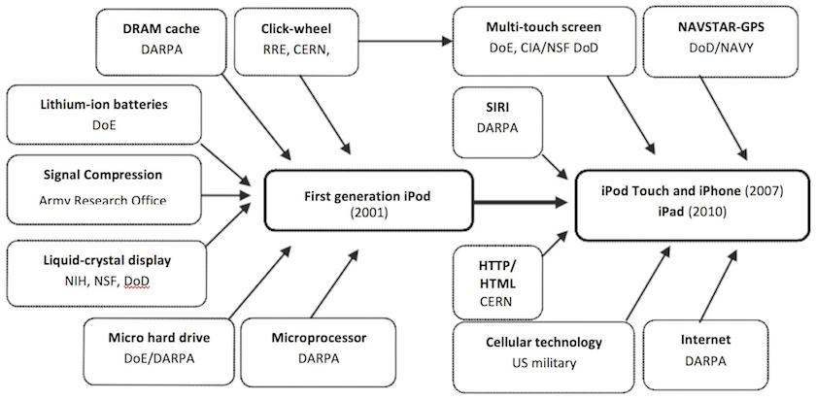
What about Steve Jobs?
"If I have seen further, it is by standing on the shoulders of giants."

Slide 19
What about Bill Gates and Tim Berners-Lee?
oN-Line System (NLS)
GUI
Onscreen Windowing with a Mouse
Hypertext Linking

Slide 20



Who funded this research?

Slide 21
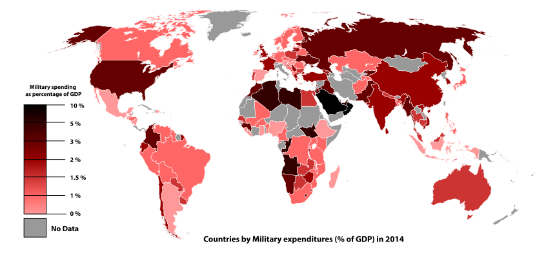
Source: Wikipedia

Slide 22

What does the future hold?

Slide 23
Thanks for listening!

Slide 24
References
References:
Slide 9:
http://www.history.com/topics/american-civil-war/civil-war-technology
Slide 10:
http://www.popularmechanics.com/military/research/g1577/7-surprising-scientific-advances-that-came-out-of-world-war-i/
Slide 11:
https://en.wikipedia.org/wiki/Cryptanalysis_of_the_Enigma
Slide 12:
https://en.wikipedia.org/wiki/Colossus_computer/
https://en.wikipedia.org/wiki/History_of_computing_hardware
Slide 13 + 14:
https://en.wikipedia.org/wiki/ARPANET
http://science.howstuffworks.com/war-drive-technological-advancement1.htm
https://www.britannica.com/topic/ARPANET
https://en.wikipedia.org/wiki/DARPA
Slide 15:
http://www.bloomberg.com/news/articles/2014-12-04/gps-as-we-know-it-happened-because-of-ronald-reagan
http://www.fleetistics.com/history-gps-satellites.php
Slide 17:
http://www.alphr.com/features/373546/10-brilliant-darpa-inventions
Slide 18:
http://www.silicon-valley-story.de/sv/militFunding.html
Slide 19:
http://www.defense.gov/News/Article/Article/686507/carter-reviews-new-technologies-from-dods-silicon-valley-unit

